Slide 1
Friends Station
Developed by
- Sundar Balamurugan

Slide 2


Slide 3
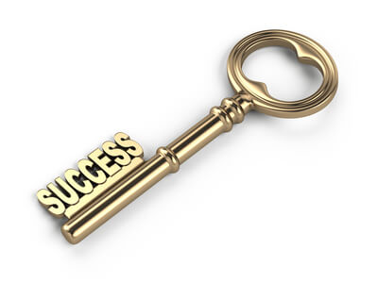

Slide 4


Slide 5


Slide 6


Slide 7


Slide 8


Slide 9

Friends Station

